Slide 1
Environment Protection
And
Islam
Waqar-e-Amal Department

Slide 2
DISCUSS!
WHY IS PROTECTING ENVIRONMENT IMPORTANT?

Slide 3
Why is protecting environment so important?
Save Lives
Prevent Natural Disasters
Protect Animals
Conserve Resources
Create Jobs
Health benefits

Slide 4
Be mindful of our resources
Share Earth with others
Scientists estimate that we humans share the planet with another 8.7 million different beings. In the world, currently 1.2 million species have been cataloged, which means more than 7 million remain unknown to science

Slide 5
DISCUSS!
How can we protect our environment?

Slide 6
Quran on Wasting
Hazrat Khalifatul Masih II writes in the tafseer of this verse that one should not over-eat.
This also includes to not waste food and water at all.
O children of Adam! look to your adornment at every time and place of worship, and eat and drink but exceed not the bounds; surely, He does not love those who exceed the bounds.
Quran 7:32

Slide 7
Hadith #1 on
Planting
"There is none amongst the Muslims who plants a tree or sows seeds, and then a bird, or a person or an animal eats from it, but is regarded as a charitable gift for him."
Sahih Bukhari 2320

Slide 8
Hadith #2
This saying of Muhammad (S.A.W) tells us the importance of planting trees.
Even if the Resurrection were established upon one of you while he has in his hand a sapling, let him plant it.
Musnad Ahmad 12902

Slide 9
Hadith #3 - Planting is a charity
Everytime someone eats of the tree, sits under its shade, a bird makes its nest e.t.c, you get the blessings!
Seven deeds of a servant continue to be rewarded after his death while he is in his grave: …. planting a date-palm tree …”
Musnad Ahmad 12902

Slide 10
Recycling
Recycling is the process of converting recyclable materials into new ones and objects. It helps to reduce the pollution caused by waste

Slide 11
Recycling
The following items should be recycled.
Do not throw in the trash!
Plastic
Glass
Paper
Metal
Bottle
Container
Bottle
Glass jar
Jam glass
Cardboard
Magazine
Newspaper
Office paper
Tetra Pak Carton
Can
Aluminum

Slide 12
What is even better than Recycling?
REUSE
Use reusable metal/plastic bottles for water.
No more recyclable bottles!
Wash spoons/forks after every use.
Do not throw!

Slide 13
Reusing
Reusing and giving a new purpose to old materials is one of the best ways to help the environment

Slide 14
DISCUSS!
What else can we reuse in our daily lives?

Slide 15
The world produces about 300 million tons of plastic waste each year. Only 9% of the plastic waste generated is recycled
Reuse!

Slide 16
Protecting
Activities
Small actions can help protect the environment from being damaged. We should take care of our planet as it’s our home
Help to protect!

Slide 17
Protecting
Activities
Think about what we could do together to protect the environment?
Let’s think together!

Slide 18
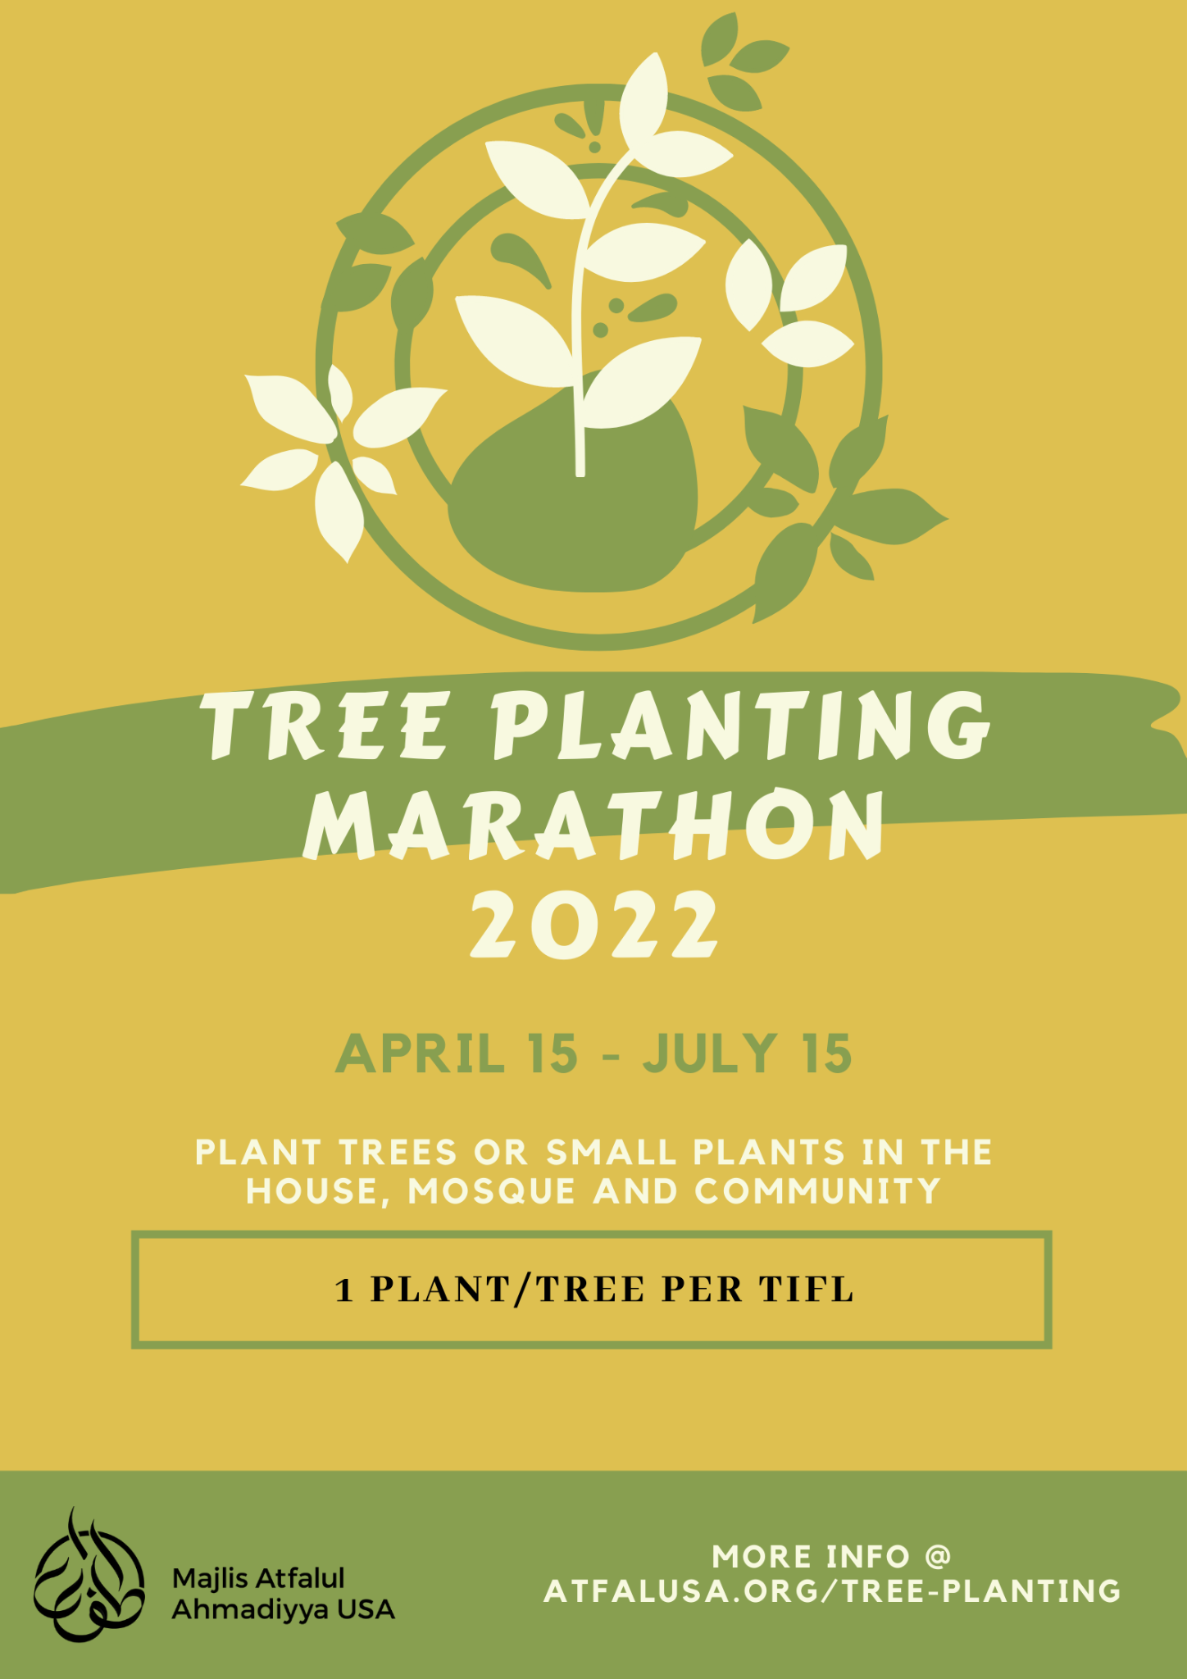
Tree Planting Marathon!
Do this activity
Protect environment
Get free blessings with one time effort!

