Slide 1
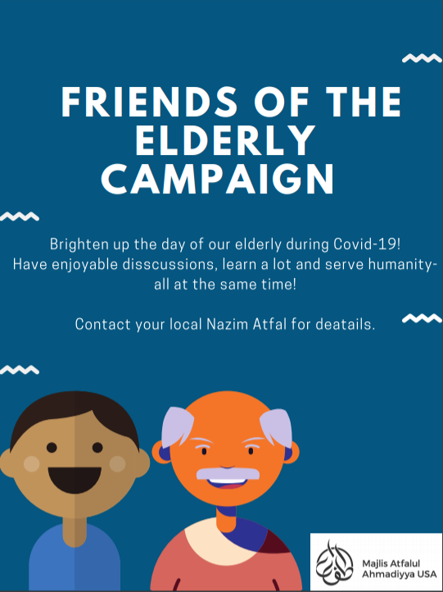
Khidmat e Khalq
Friends of the Elderly Campaign

Slide 2
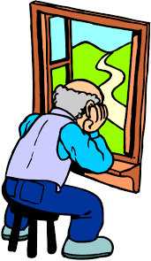
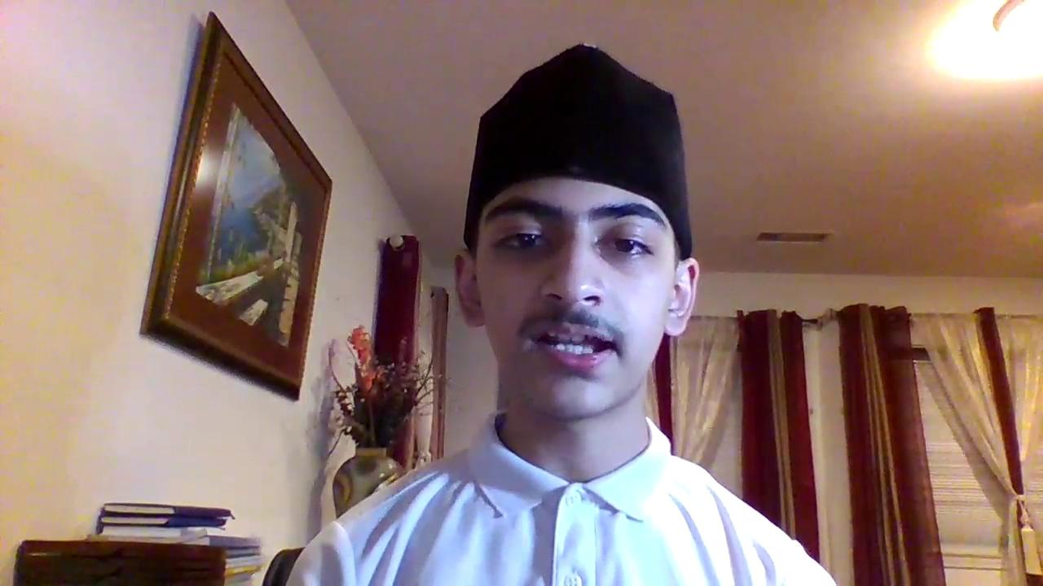
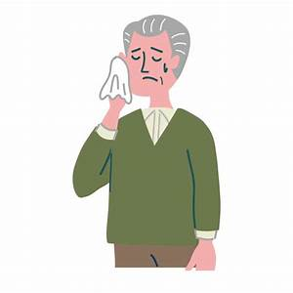
Pandemic has greatly affected the Elderly
Elders may feel lonely and want to interact with others. Social isolation increases risk of depression, anxiety, heart disease.
56% of 50 - 80 year olds often or sometimes felt isolated from others in June 2020 (University of Michigan National Poll on Healthy Aging )
Video link: https://drive.google.com/file/d/1Va6VhrNyzF1ejS-W-BoE6Oyedhwu15Q0/view?usp=sharing

Slide 3
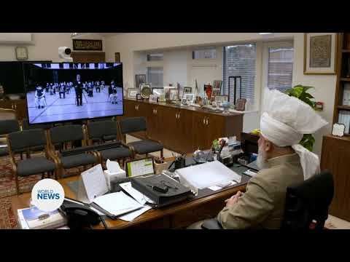
Huzoor (aba)’s Guidance
Link: https://www.youtube.com/watch?v=58YQ8xwHvC4 (Begin at 0:25 and End 0:57)

Slide 4
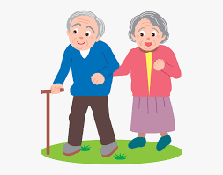
Friends of the Elderly Campaign
Get paired with an elderly jamaat member. Call them once weekly on at least 3 occasions.
Have enjoyable discussions, brighten their day, seek their wisdom, develop a relationship.
Serve Humanity!
Video Link: https://drive.google.com/file/d/1cAB7BkCBQs5iwH0OtitZXR-x1VYZOHXO/view?usp=sharing

Slide 6
JazakAllah!

